Slide 1
Data-Driven Insights for Digital Marketing Campaigns

Slide 2
Data Cleaning
The most important cleaning tasks are:
Checked all Column data formats.
Checked for Unnamed columns.
Checked for Null value.
Convert time fields (11s, 1m 49s) to numeric seconds.

Slide 3
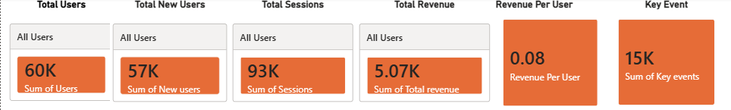
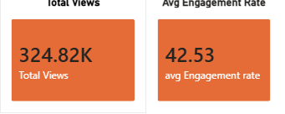
Important KPI’s from Data Set

Slide 4
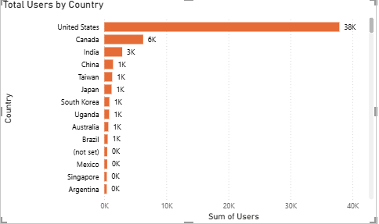
Country Wise User Total
Country wise Total User count shown in Bar Chart.
As per Chart United States top the list and Canada, India second and three positions.

Slide 5
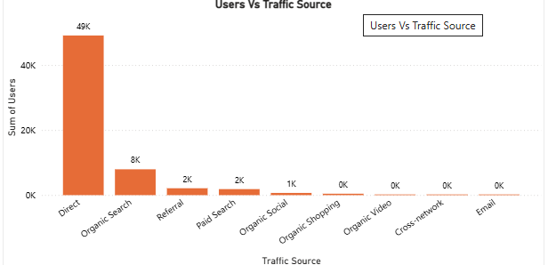
Traffic Source Wise User Count
As per Bar Chart Direct User top first and Organic Search second in the list.

Slide 6
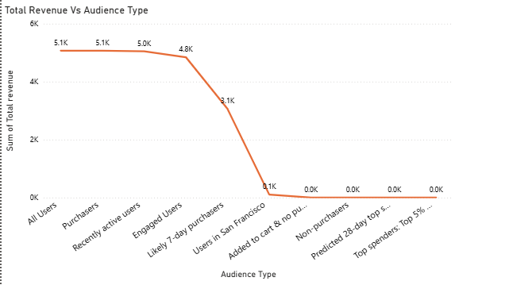
Total Revenue Audience Type Wise
All user has highest Revenue followed by purchasers.
Recently active users and Engaged User in third and fourth position.

Slide 7
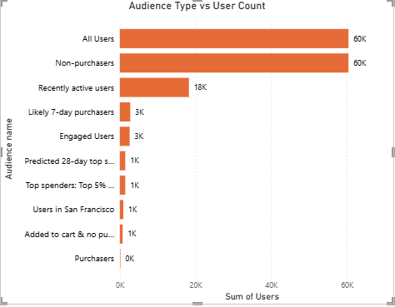
Total User Count for Audience Type
All User and Non Purchaser are on top of list with Same Count.

Slide 8
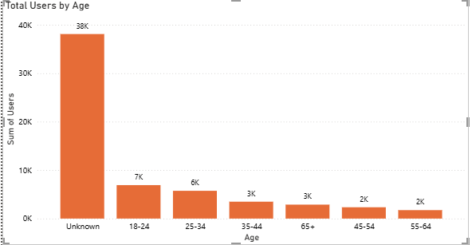
Total User by Age
Unknown Age group top the list
And 18-24 Age Group Seconds the list.
55-64 Age Group is the last.

Slide 9
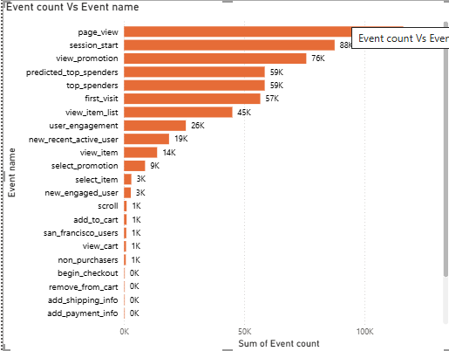
Event Count
Page view has highest Event Count.
Non purchaser Least Count.

Slide 10
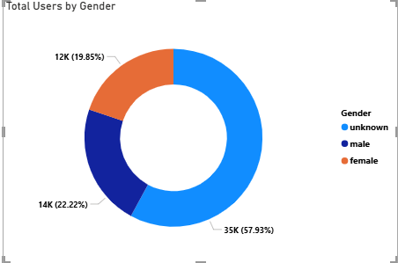
Total User by Gender
Unknown Gender Has 57.93% highest.
Male Gender 22.2% and Female 19.85%.

Slide 11
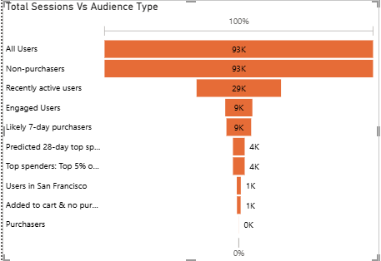
Total Session by Audience Type
All Users has Highest Total Sessions followed by Non Purchasers.
Purchasers has Least sessions total.

Slide 12
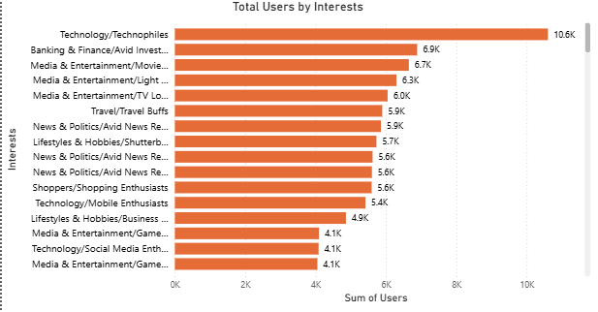
Total Users by Interest
First Place in User interest Wise is Technology/Technophiles
Second place for Banking & Finance/Avid Investors
Third Place for Media & Entertainment/Movie Lovers

Slide 13
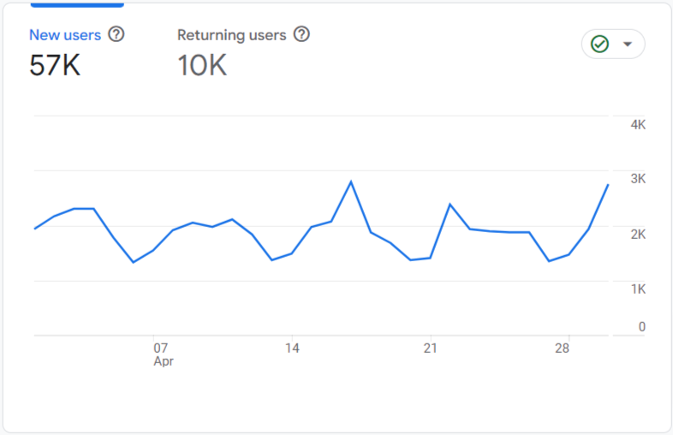
Retention Overview
In Total 67K user, 57K New user and 10k old user.
In Percentage 15% user are old and 85% User are New users.

Slide 14
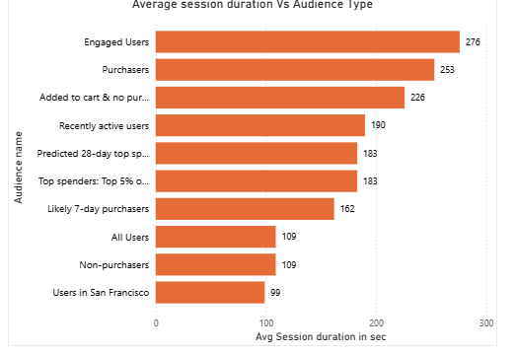
Average Session duration
Engaged Users Has Highest Avg Session Duration.
Non Purchasers and Users in San Francisco Has Least Avg Session Duration.

Slide 15
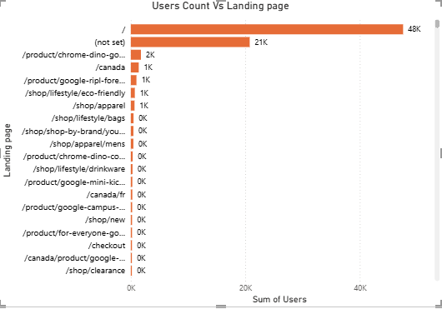
User Count for Landing Page
/ and (not set )two page has highest User and Session Count.

Slide 16
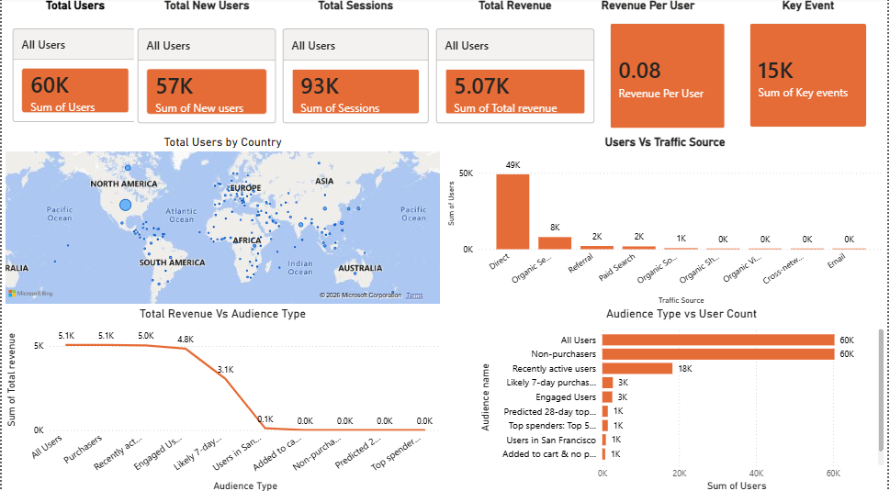

Slide 17
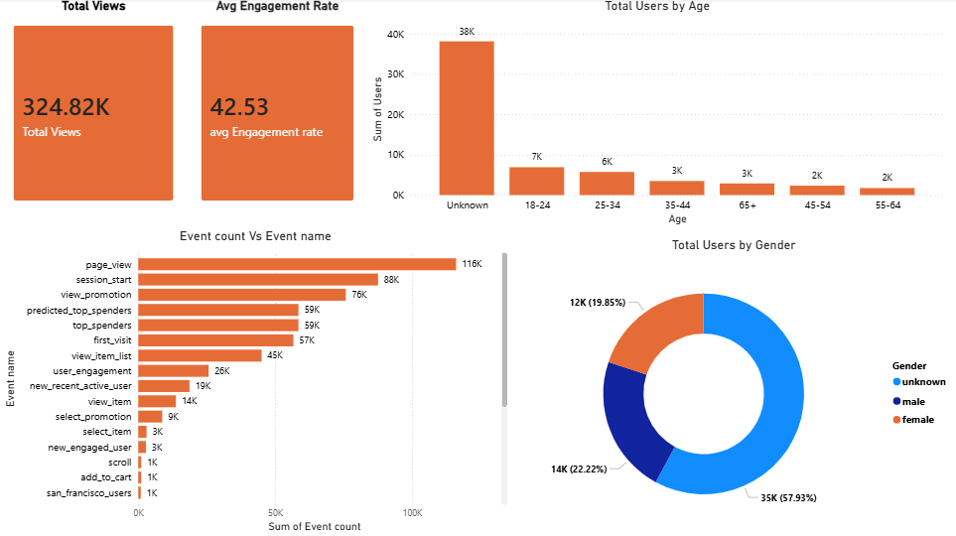

Slide 18
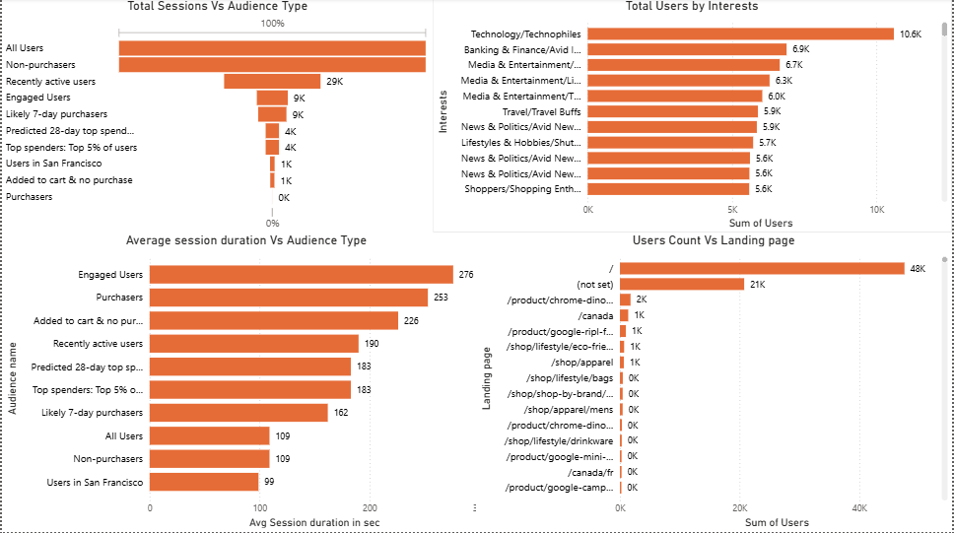

Slide 19
Recommendations
Age Group
For Age Group 25-34 and 35-44 has Highest Engagement Rate than 18-24 age Group which has high number of Users.
62% of Users Age Group data missing which is very important.
Country
Among 156 Countries having users but Revenue generated only Through three Countries US, Indonesia and Qatar.
Event Count and Engagement Rate High Countries need to Identify and focus on Remarketing Campaigns.
Interest
Technology/Technophiles ,Media & Entertainment/Movie Lovers and Media & Entertainment/Light TV Viewers has high user and Revenue. So we can Increase count of this three type of content in Future Campaigns.

Slide 20
Recommendations
Gender
In Total 58% of Data Missing for Gender Data availed .
Revenue wise Female Gender has high than male. More Focus on Female Users
Loading Page-Improve Conversion Rate
Total Users are high, but Revenue is relatively low.
Large gap between Visitors → Key Events → Purchases.
Recommendation to Optimize landing pages with:
Stronger CTAs - Simplified forms - Faster page load speed - Trust signals (reviews, ratings)
Expected Outcome: Higher conversion rate and revenue per user.
Remarketing
Launch remarketing campaigns for non-purchasers.
Focus on audience segments with highest engagement and revenue.

Slide 21
Recommendations
Focus on High-Performing Traffic Sources and Increase investment those channels
Direct -Organic Search-Referral
Based of these three channel Brand Awareness is Good.
Scale SEO efforts to increase Organic Search traffic.
Strengthen Social Media marketing.
Expand referral partnerships.
Paid Search
Keyword targeting-Landing page relevance-Budget allocation
Optimize Paid Search campaigns for better ROI.
Organic Social
Increase content frequency
Email -Build an Email Marketing program.

Slide 22
Recommendations
Launch remarketing campaigns for non-purchasers.
Focus on audience segments with highest engagement and revenue.

